Slide 1
LEADERSHIP
BY: Shahtaj Shakir
Fast-nuces , karachi

Slide 2
LEARNING outcomes
Recipe for being a Leader
Understanding Leadership styles

Slide 3
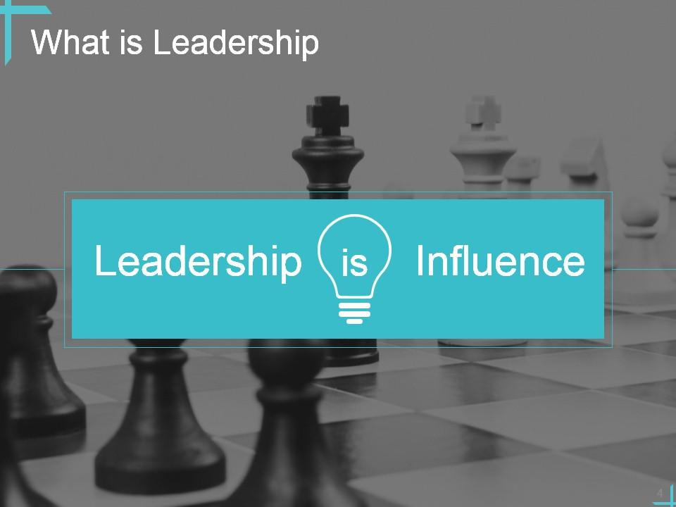

Slide 4
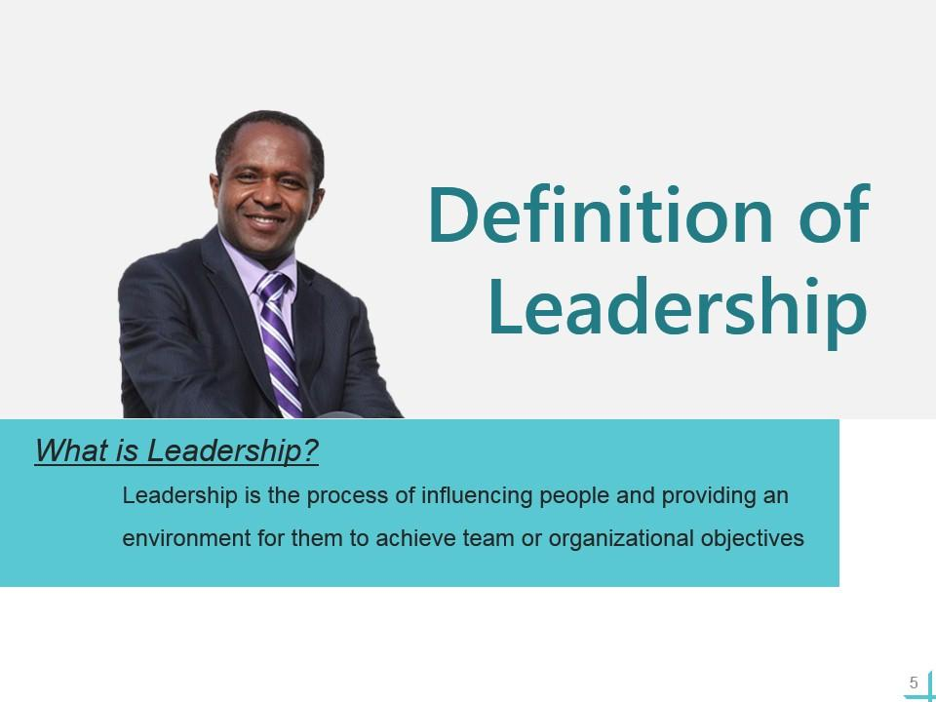

Slide 5
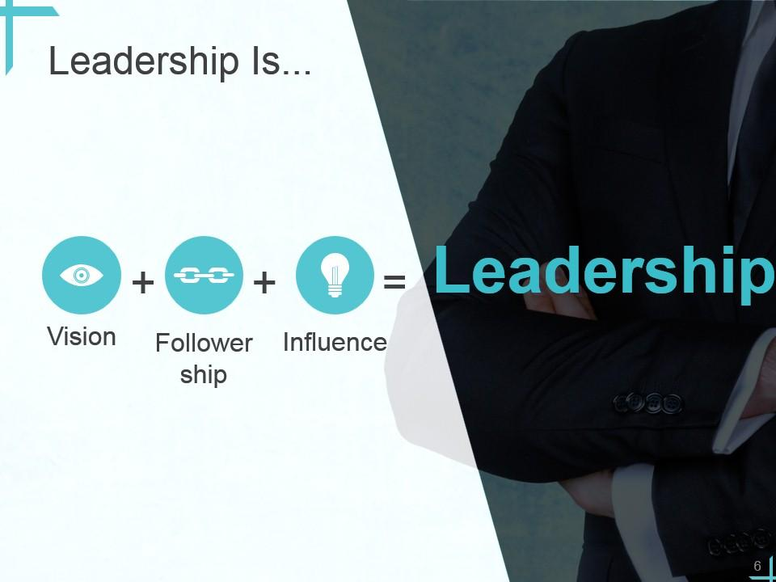

Slide 6
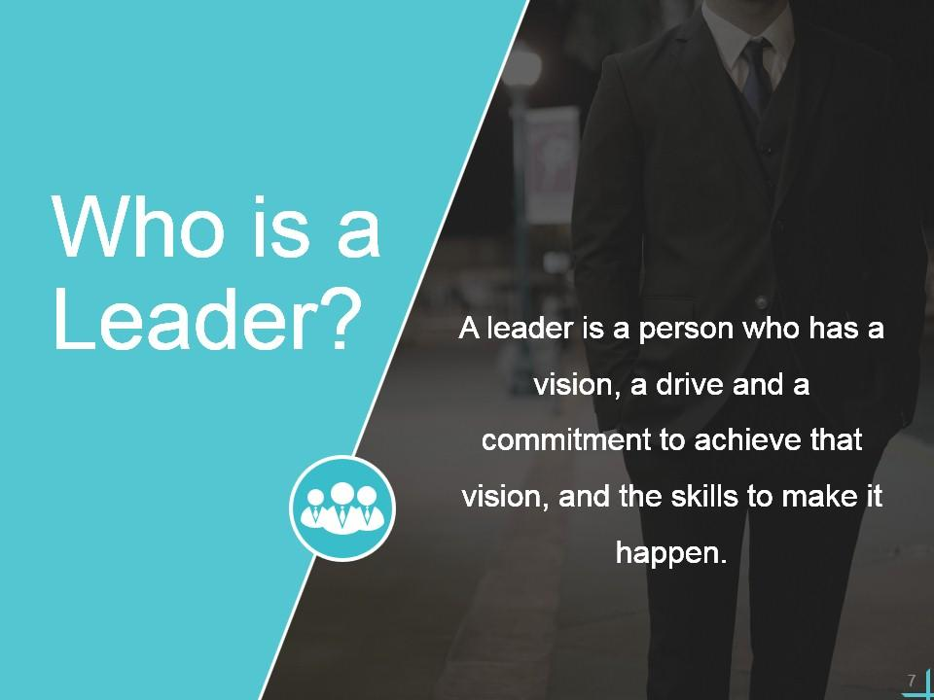

Slide 7
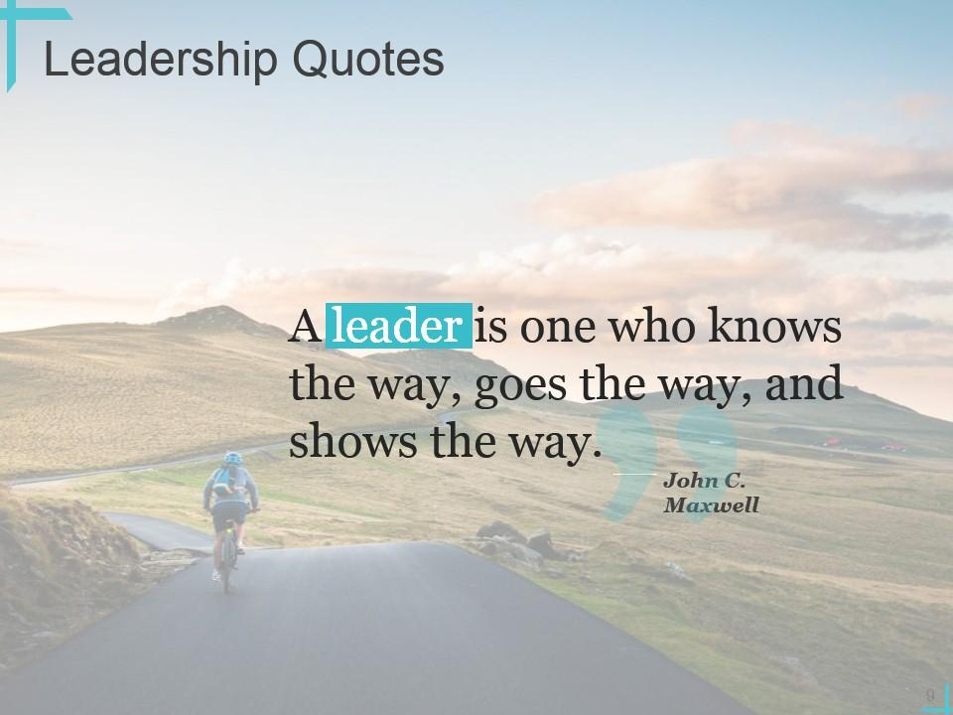

Slide 8
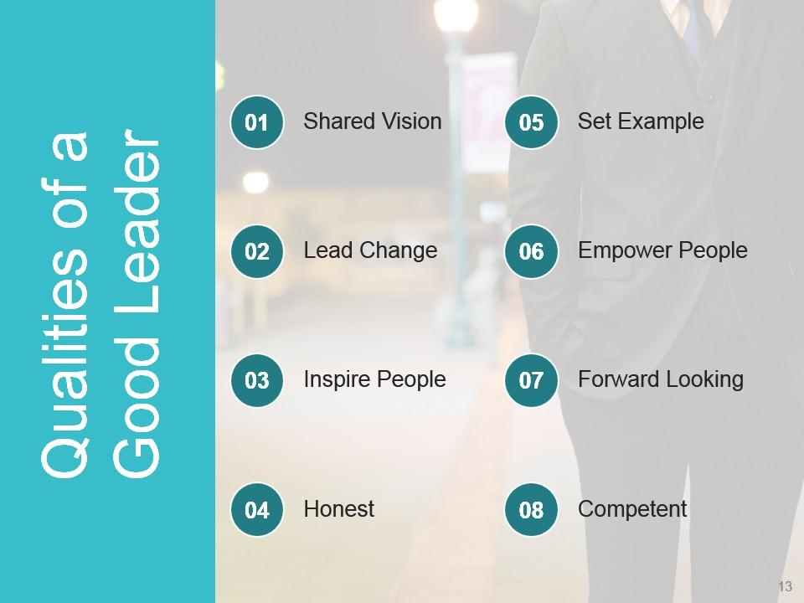

Slide 9
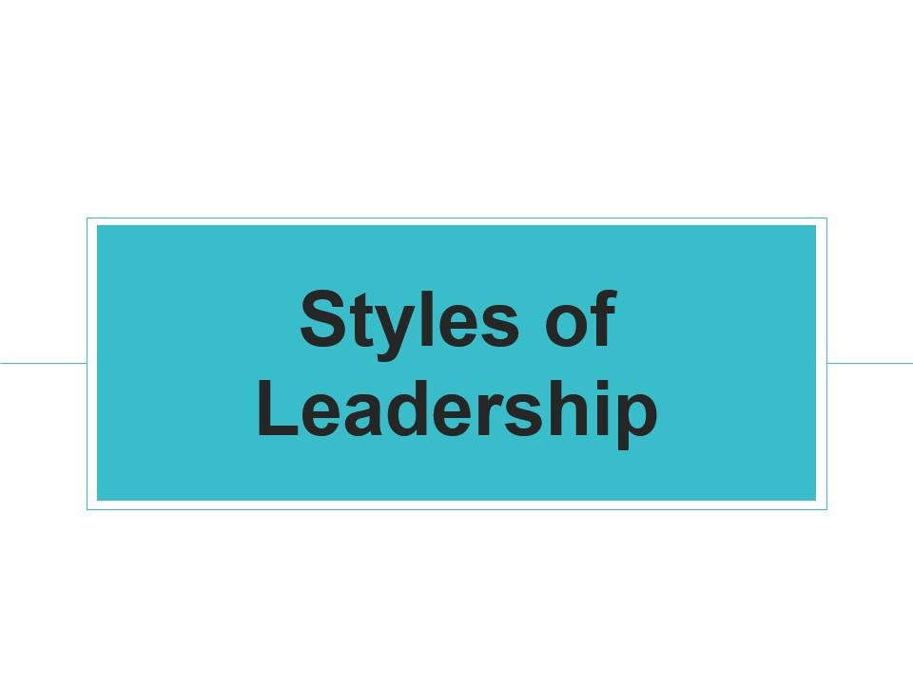

Slide 10
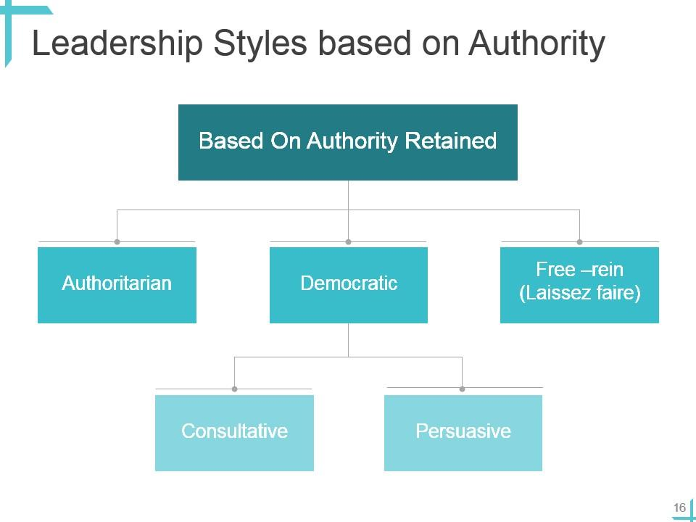

Slide 11
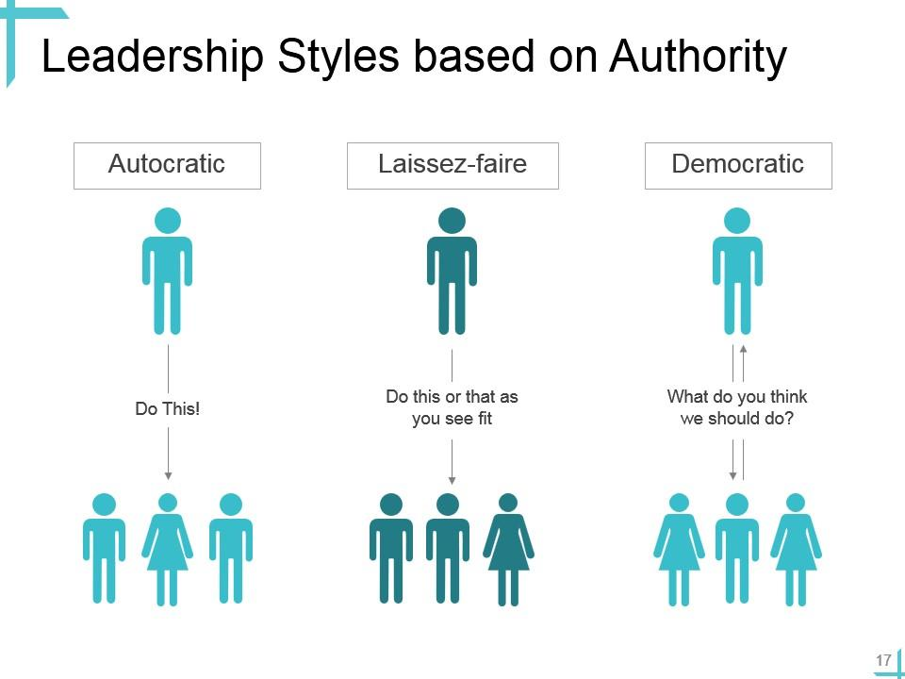

Slide 12
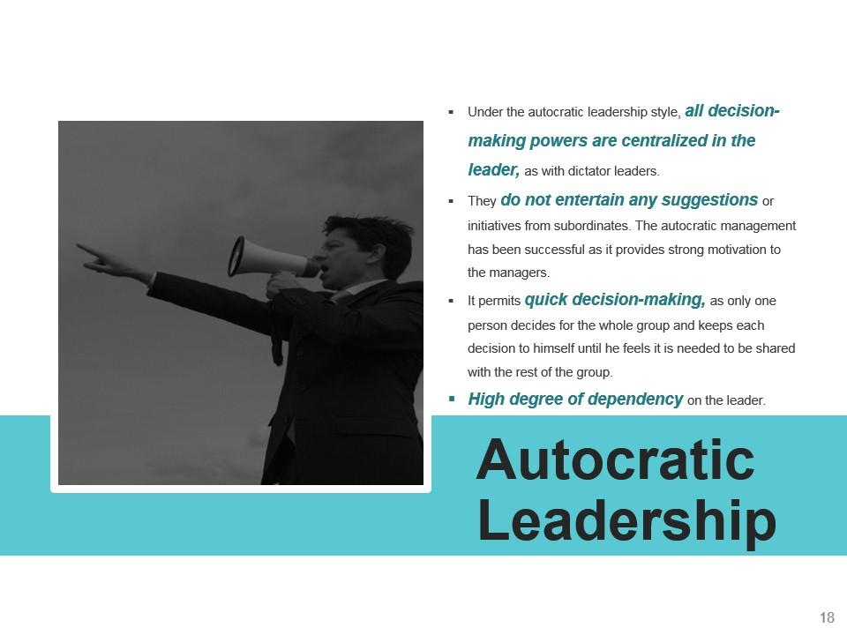

Slide 13
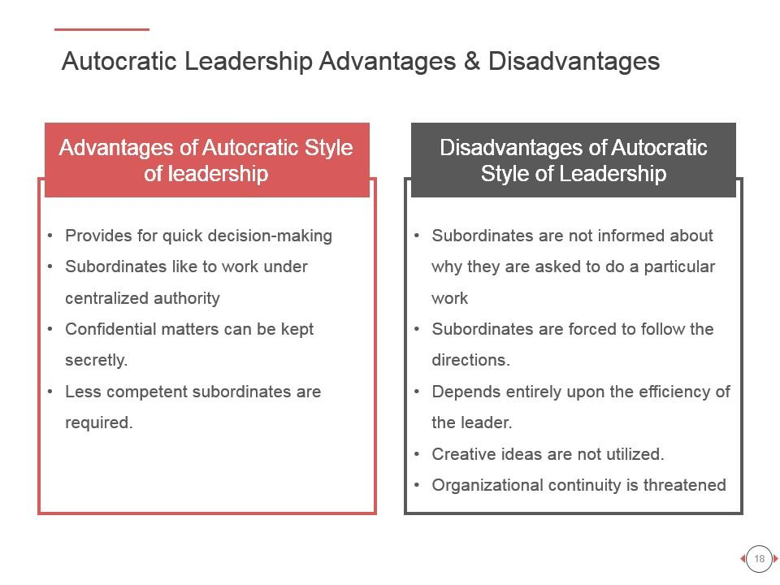

Slide 14
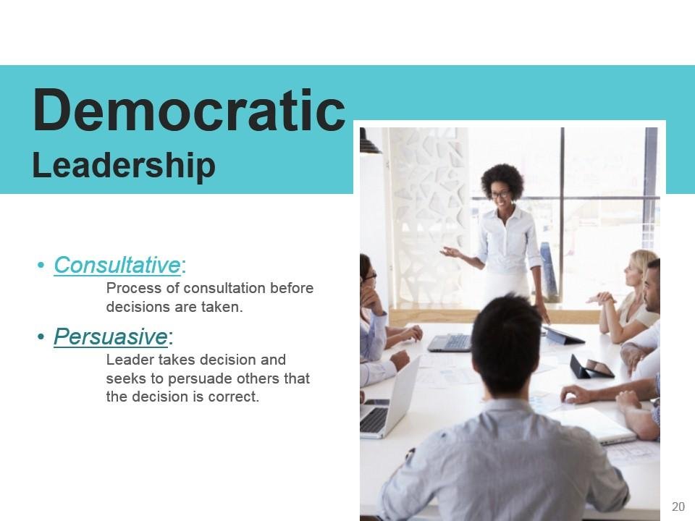

Slide 15
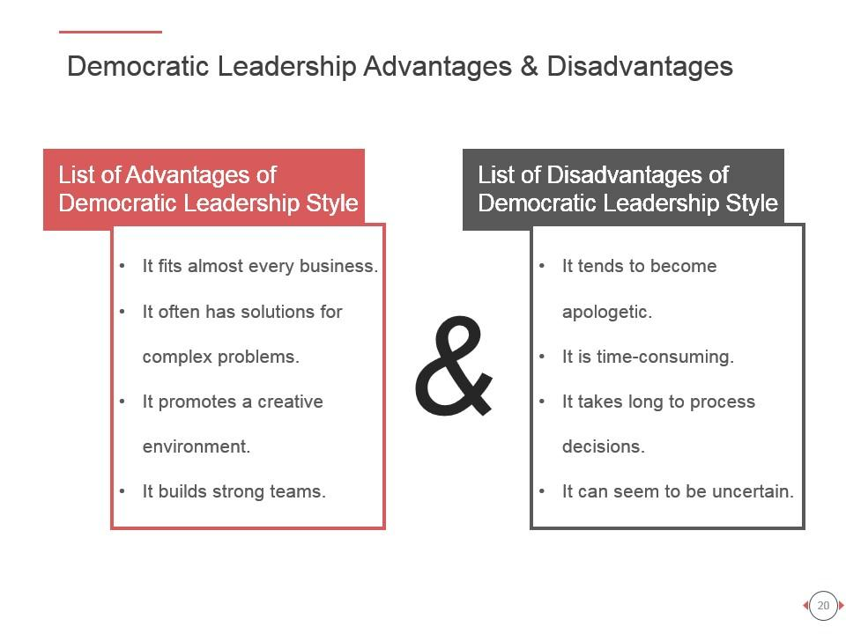

Slide 16
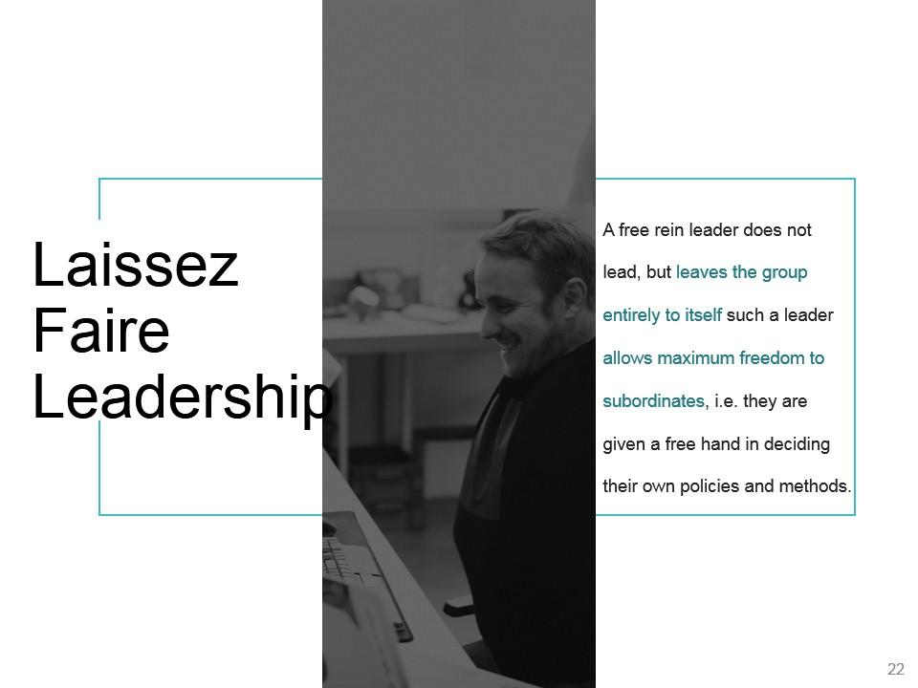

Slide 17
‘Let it be’ – the leadership responsibilities are shared by all
Can be very useful in businesses where creative ideas are important
Can be highly motivational, as people have control over their working life
Can make coordination and decision making time-consuming and lacking in overall direction
Relies on good team work
Relies on good interpersonal relations

Slide 18
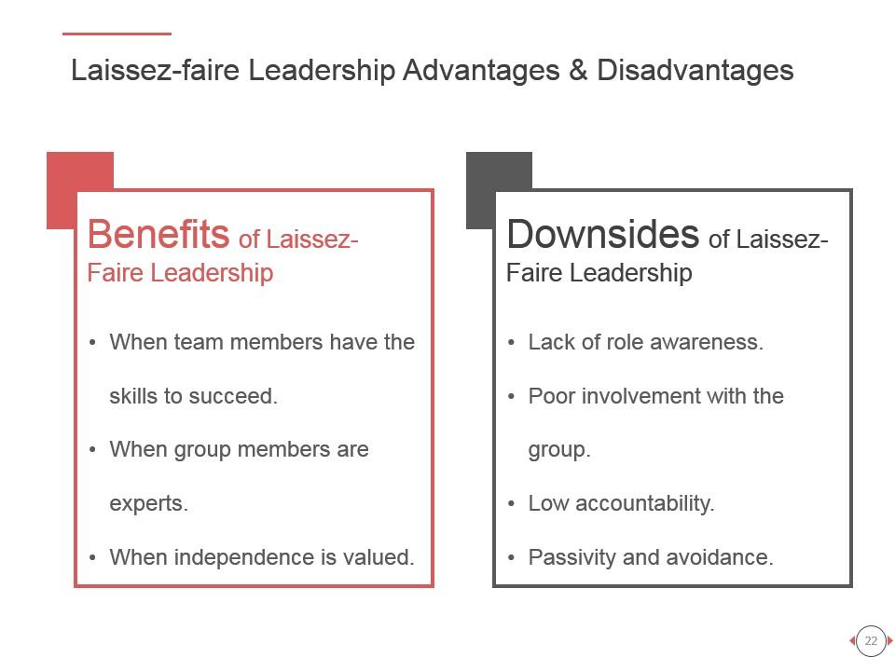

Slide 19
Recipe for being a Leader
Take control of your life.
Have vision, courage and commitment
Assume responsibility for who you are
Accept blame: learn from your own mistakes as well as those of others. Take blame for everything that happens in your unit
Give credit wherever it is due
Be compassionate when you review your team members' progress.
Think great thoughts. Small thinking is why companies go broke
When you want to tell someone something important, do it personally
Listen effectively
Encourage teamwork and participation
Empower team members

Slide 20


